Slide 1

Mask Detection using Machine Learning
J.C. Bose University of Science and Technology, YMCA
Supervision of:
Ms. Shivi Garg
Presented by:
Jatin Arora
(17001003023)
Aayush Bangroo (17001003001)
1

Slide 2

Contents
Motivation
Objective and Problem Statement
Libraries used
Methodology
Mask detection
References

Slide 3
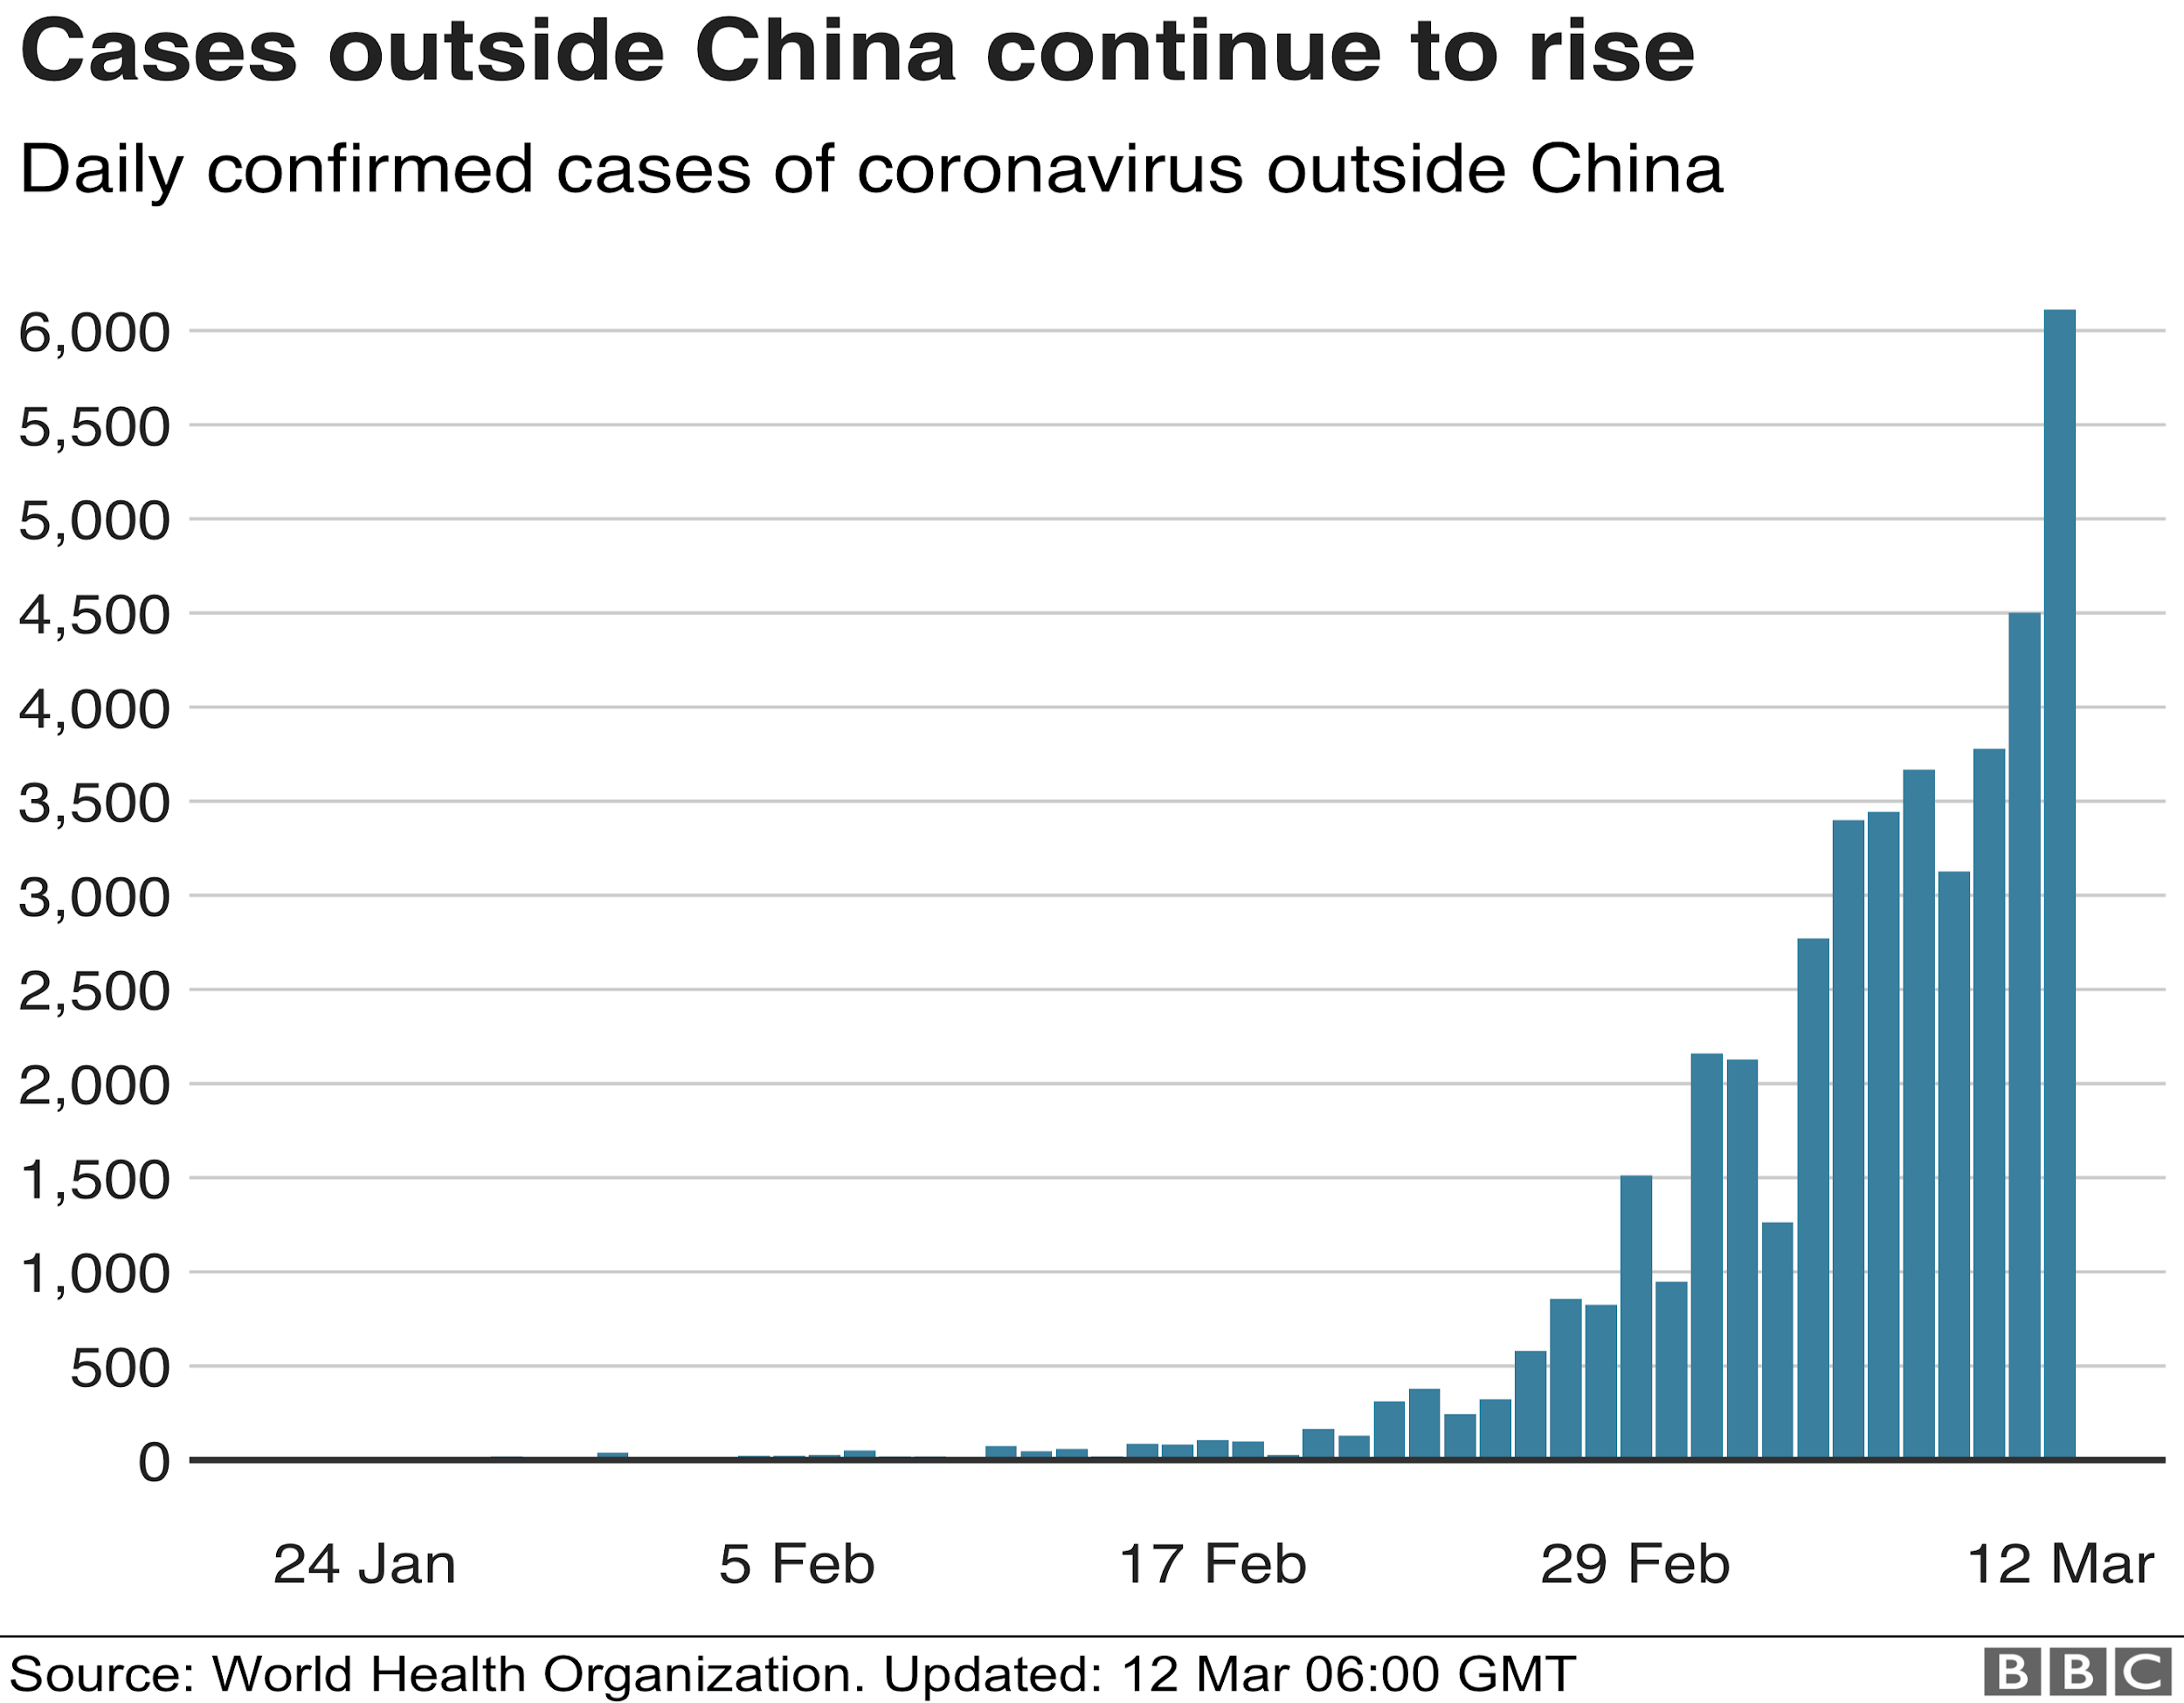
Motivation
Corona Virus is spreading all over the world and there are necessary precautions that need to be taken to contain its spread. According to data obtained by the World Health Organization, the global pandemic of COVID-19 has severely impacted the world and has now infected more than eight million people worldwide.
Wearing face masks and following safe social distancing are two of the enhanced safety protocols need to be followed in public places in order to prevent the spread of the virus.
Face masks have proven to be most effective precautionary measure to contain the spread of the virus.
Figure 1. Corona cases in China.

Slide 4
Objective and Problem statement
The primary objective of our project is to embed Computer Vision in monitoring systems such as CCTV cameras.
It is not possible to keep an eye on the surroundings every time and determine each and everyone is wearing mask
Places that require utmost surveillance still remain at risk of becoming hotspot
Design and evaluate an effective approach for Mask Detection using Machine Learning Techniques

Slide 5
Language and Libraries Used
Language: Python 3
OpenCV: OpenCV is a library of programming functions mainly aimed at real-time computer vision.
Keras: Keras is an open-source neural-network library written in Python.
Tensorflow: TensorFlow is a free and open-source software library for dataflow and differentiable programming across a range of tasks.
Sklearn: Scikit-learn is a free software machine learning library for the Python programming language. It features various classification, regression and clustering algorithms

Slide 6
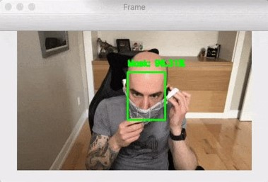
Methodology
Mask Detection:
Mask detection is another important feature to detect suspicious activity of thieves who usually wear masks.
For the mask detection we used hybrid model in which we first detect the face using Haar cascade and then detected the mask on the face using Mobilenet trained on the weights of Imagenet.
In order to train a custom face mask detector, we need to break our project into two distinct phases, each with its own respective sub-steps:
Phase 1: Train the mask detector.
Phase 2: Apply Face mask detector.
Training: In this phase we load our face mask detection dataset from disk and use it to train a model using Keras/TensorFlow) , and then serialize the face mask detector to disk .
Once the face mask detector is trained, we then move on to loading the mask detector, performing face detection, and then classifying each face as with mask or without mask.
Fig. Functioning of mask detector

Slide 7
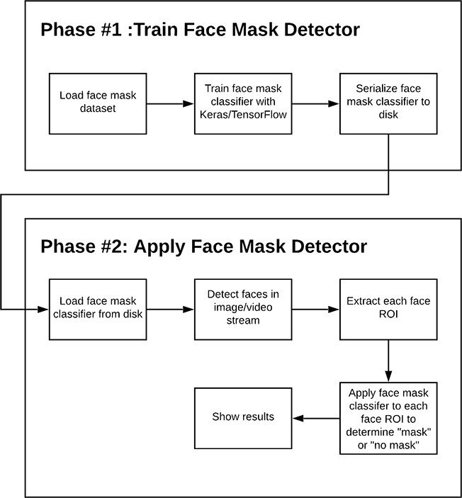
Use case diagram:

Slide 8
References
Agarwal, S., Punn, N.S., Sonbhadra, S.K., Nagabhushan, P., Pandian, K., Saxena, P.: Unleashing the power of disruptive and emerging technologies amid COVID 2019: a detailed review. arXiv preprint arXiv:2005.11507 (2020)
Chollet, F.: Xception: deep learning with depthwise separable convolutions. CoRR abs/1610.02357 (2016).
Ejaz, M.S., Islam, M.R., Sifatullah, M., Sarker, A.: Implementation of principal component analysis on masked and non-masked face recognition. In: 2019 1st International Conference on Advances in Science, Engineering and Robotics Technology (ICASERT), pp. 1–5 (2019)
Howard, A.G., et al.: MobileNets: efficient convolutional neural networks for mobile vision applications. CoRR abs/1704.04861 (2017).
https://www.pyimagesearch.com/2020/05/04/covid-19-face-mask-detector-with-opencv-keras-tensorflow-and-deep-learning/

